Slide 1
DEPARTMENT OF MODERN LANGUAGES 2020-2021 FIRST DAY PRESENTATION

Slide 2
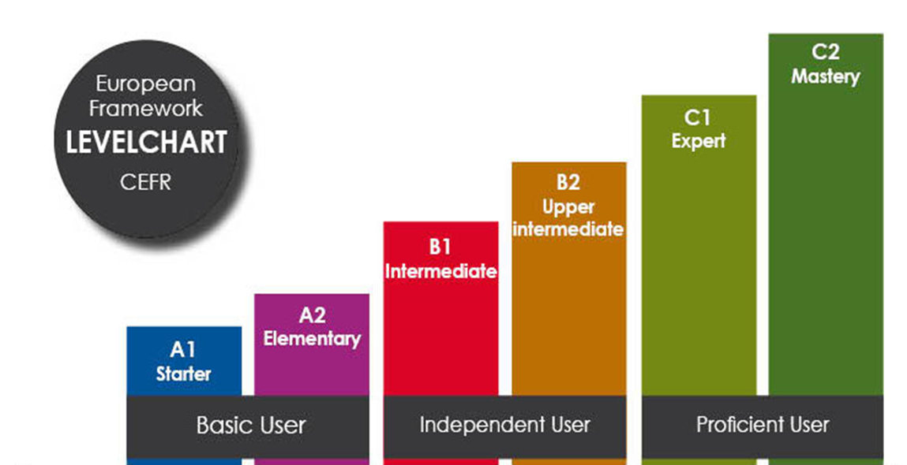
Levels in DML courses: A2 & B2
ADVANCED ENGLISH 1/2 & READING AND SPEAKING IN ENGLISH & BUSINESS ENGLISH
ENGLISH 1/2
Common European Framework of Reference

Slide 3
THE COURSES GIVEN BY DML
COURSE CODE | COURSE TITLE | COURSE TYPE | COURSE LEVEL | PREREQUISITE | TERM | SEMESTER | LOCAL CREDIT | LECTURE (hour/week) | MODE OF DELIVERY
MDB1031 | ADVANCED ENGLISH I | Compulsory for 30% and 100% Eng Depts. | Upper Intermediate | Preparatory Class | 1 | Fall | 3 | 3 | Face-to-face (Online during 20-21 Academic Year)
MDB1032 | ADVANCED ENGLISH II | Compulsory for 30% and 100% Eng Depts. | Upper Intermediate | Preparatory Class | 2 | Spring | 3 | 3 | Face-to-face (Online during 20-21 Academic Year)
MDB1051 | ENGLISH I | Compulsory for 100% Turkish Depts. | Elementary | None | 1 | Fall | 3 | 3 | Face-to-face OR Online (Online during 20-21 Academic Year)
MDB1052 | ENGLISH II | Compulsory for 100% Turkish Depts. | Elementary | None | 2 | Spring | 3 | 3 | Face-to-face OR Online (Online during 20-21 Academic Year)
MDB1091 | ENGLISH I | Compulsory for Faculty of Education depts. | Elementary | None | 1 | Fall | 2 | 2 | Face-to-face OR Online (Online during 20-21 Academic Year)
MDB1092 | ENGLISH II | Compulsory for Faculty of Education depts. | Elementary | None | 2 | Spring | 2 | 2 | Face-to-face OR Online (Online during 20-21 Academic Year)
MDB2051 | READING AND SPEAKING IN ENGLISH | Social Elective for 30% and 100% Eng Depts. | Upper Intermediate | None | 3 | Fall | 2 | 2 | Face-to-face (Online during 20-21 Academic Year)
MDB3032 MDB3042 | BUSINESS ENGLISH | Social Elective for 30% and 100% Eng Depts. | Upper Intermediate | None | 6 | Spring | 2 | 2 | Face-to-face (Online during 20-21 Academic Year)

Slide 4
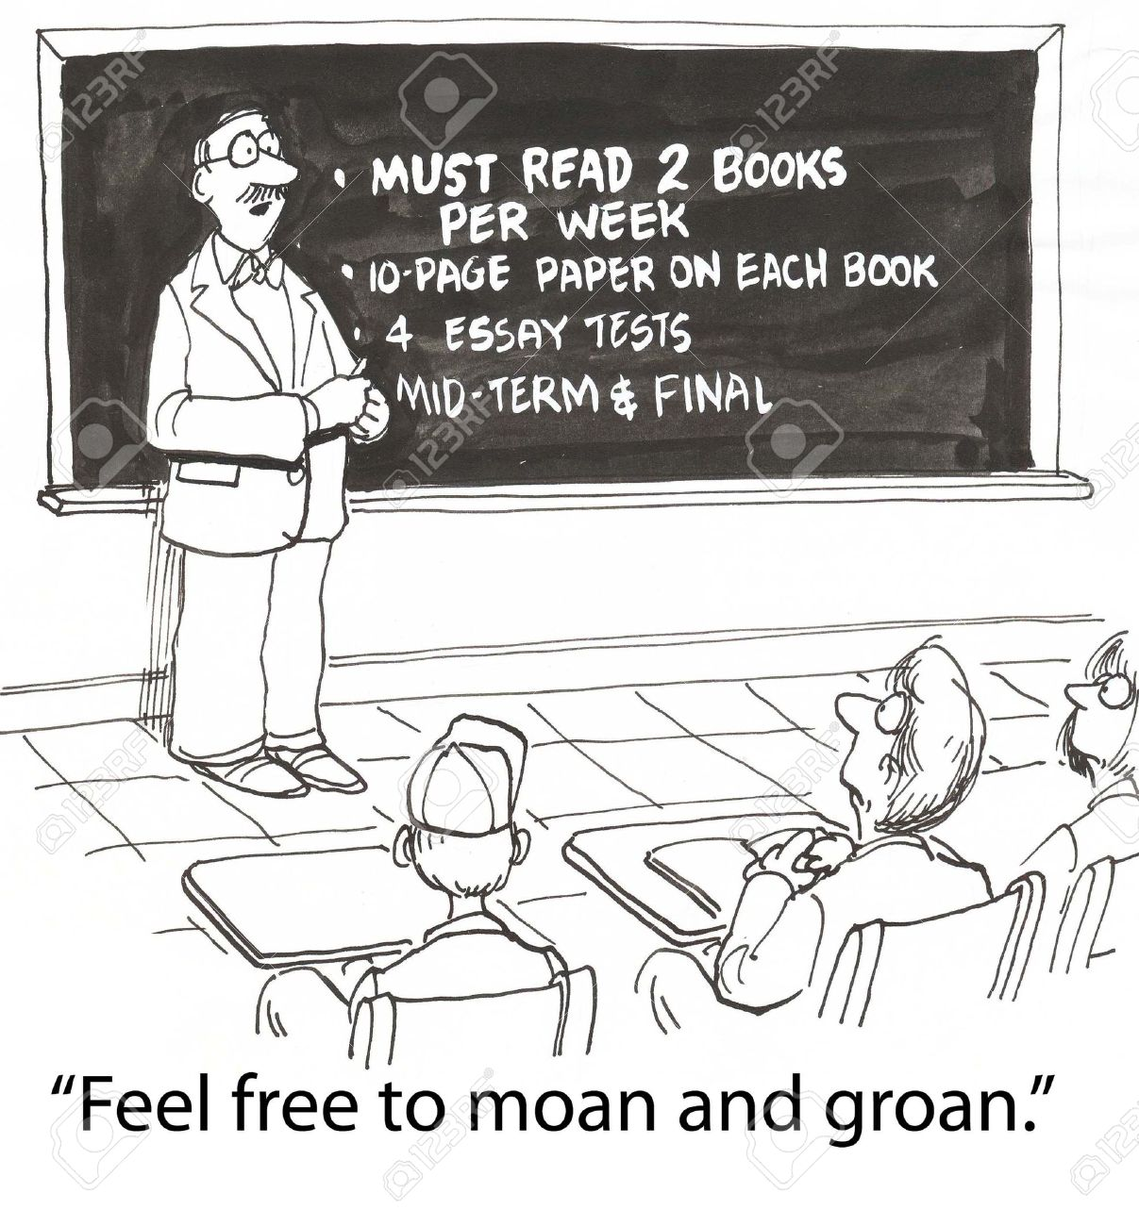
Course Requirements & Assessment in DML Courses

Slide 5
Attendance
70% attendance is required in DML courses.
3-credit courses have a total of 12 hours of absence. Students who exceed this limit fail the course with the grade “F0”.
2-credit courses have a total of 8 hours of absence. Students who exceed this limit fail the course with the grade “F0”.
No matter what students’ level of language is, instructors cannot permit them not to attend the course for that reason by taking the initiative. All students have to attend the course regardless of their level.

Slide 6
Assessment for Online
ASSESSMENT
 | PERCENTAGE
In-term Assessment | 60
FINAL EXAM | 40
 | 100%

Slide 7
GRADING SCALE
GRADE | LETTER | ECTS
90-100 | AA | 4.00
80-89 | BA | 3.50
70-79 | BB | 3.00
60-69 | CB | 2.50
53-59 | CC | 2.00
48-52 | DC | 1.50
40-47 | DD | 1.00
30-39 | FD | 0.50
0-29 | FF | 0.00
ABSENTEE | F0 | 0.00

Slide 8
Moodle platform
STUDENT REGISTRATION
&
ACCESS TO COURSE INFORMATION AND MATERIALS

Slide 10
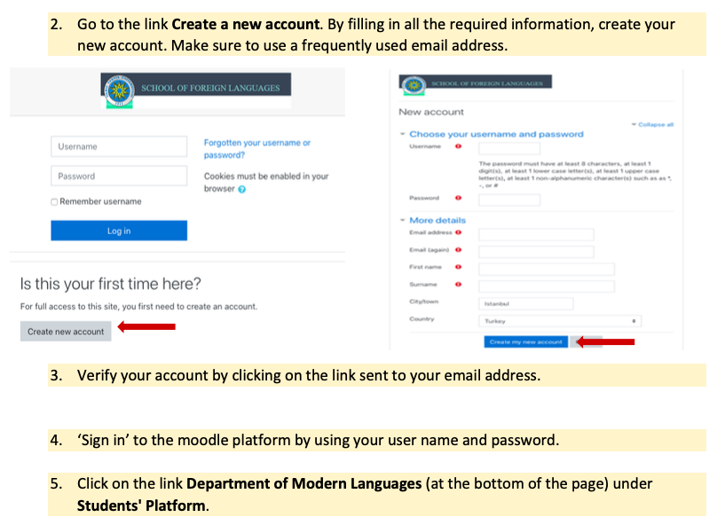

Slide 11
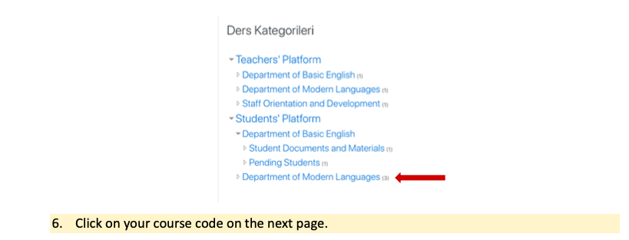

Slide 12
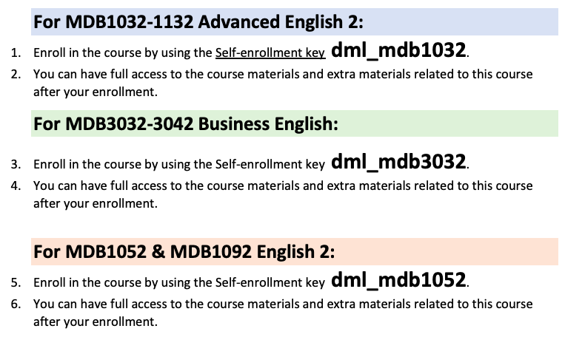

Slide 13
Course Information for MDB1032 Advanced English 2

Slide 14
Course Description
MDB1032 Advanced English 2 (SPRING) is a 3-credit compulsory course for the students of departments in which 30% or 100% of the coursework is in English.
Advanced English I is not a prerequisite for Advanced English II. However, it should be kept in mind that these two courses are designed to improve language skills in a constructive trend; that is, Advanced English II is like a follow-up to Advanced English I. Therefore, it would be wise for students to take-up these courses respectively.

Slide 15
The reading component
supporting the students’ exposure to a specified range of text complexity and text types across a wide range of disciplines aligned to college and career readiness
putting an emphasis on source analysis (reading, analyzing, and using reasoning to comprehend reading texts)
reinforcing an understanding of relevant Academic Word List words in context and how word choice helps shape meaning and tone

Slide 16
Regarding the reading skill, Advanced English II course reinforces the students’ ability to
use different reading strategies,
Identifying key points in a text
identify main idea and supporting details,
read analytically,
infer information from the passage,
recognize the main patterns of a text and the relationships among facts and ideas in different parts of a passage,
understand the author’s purpose,
understand vocabulary in context.

Slide 17
The writing component
facilitating students’ ability to comprehend appropriately chosen source texts to craft an effective analysis
encouraging students to write a purposeful and organized summary of a 700-1000 word text and writing a response to the ideas presented in the text.

Slide 18
Please remember!
Academic misconduct like plagiarism and cheating are punishable according to YTU SFL Student Disciplinary Action Regulations and Disciplinary Action Regulation for Students at Higher Education Institutions.

Slide 19
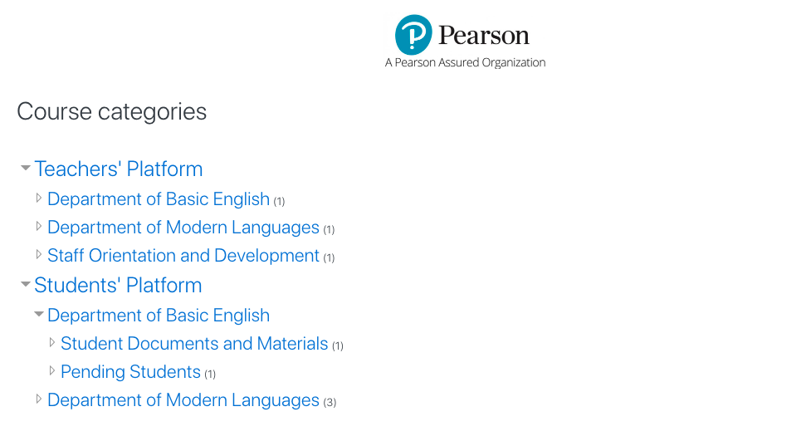
Course pack & Supplementary Materials
can be found on:
https://moodleybd.yildiz.edu.tr/

Slide 20
Course Information for MDB3032 BUSINESS English

Slide 21
Course Description
This is an upper-intermediate 2-credit social elective course for the students of departments in which 30% or 100% of the coursework is in English. The students who completed their preparatory classes or who have been successful in the exemption test can take up Business English course.
Advanced English I, Advanced English II, and Reading and Speaking in English are not a prerequisite for this course. However, it should be kept in mind that this course is designed to improve language skills in a constructive trend focusing on language skills necessary for professional life. Therefore, it would be wise for students to take-up Advanced English I, Advanced English II, Reading and Speaking in English and Business English courses respectively.

Slide 22
Course Design
The priority in the design of Business English course is to help students gain oral and written communicative skills for business life, especially for foreign companies or establishments.
The students who take up Business English course will be able to use proper vocabulary and language patterns in appropriate business contexts, get to know workplace protocols through listening, speaking and writing activities and learn how different people from different cultures act in the business environment, learn teamwork with the help of group activities.
The general outline of the course includes business life matters like socializing in business environments, telephone conversations, meetings, interviews, business correspondence, and presentations.

Slide 23
Course pack & Supplementary Materials
can be found on:
https://moodleybd.yildiz.edu.tr/

Slide 24
Course Information for MDB1052/1092 English 2

Slide 25
Course Description
These basic English courses are 3-credit (1052) and 2-credit (1092) compulsory courses for the students of departments in which 100% of the coursework is in Turkish.
The students of MDB1052 and MDB1092 follow the same weekly plan.

Slide 26
Course Description
English II is designed to improve the students’ communication skills necessary in daily life situations encompassing listening and speaking at elementary level.
The students who take up these courses will be equipped with the necessary grammatical structures (the present progressive tense, present simple tense, future tense, and simple past tense, Wh- questions, modals, adjectives of comparison, adverbs of frequency, the future tense, simple past tense, present perfect tense, modals, comparatives and superlatives, linking words) with the aim of improving four basic language skills.
The students will also be able to read different reading texts and produce written texts (e-mails, self-introduction, posters and forms, recipes).

Slide 27
Coursebook & Suggested Materials
Pioneer (Elementary)
(MM Publications)
Extra materials & sources
will be uploaded to
https://moodleybd.yildiz.edu.tr/

